Slide 1
Detecting Market Manipulation: Forecasting Pump and Dump Schemes in Cryptocurrency
Presentation : II
Date : 2024/11/14
Ajeet Kumar Rai
Department of Applied Mathematics and Statistics, Stony Brook University
ajeetkumar.rai@stonybrook.edu

Slide 2
INTRODUCTION
The project aims to predict pump and dump events in cryptocurrency markets.
Manipulators artificially increase prices (pump) and then sell (dump), causing prices to fall.
The goal is to detect early signs of such manipulation to protect investors from potential losses.

Slide 3
PUMP AND DUMP
Initial Price: The price of cryptocurrencies with low volume starts at $100.
Pump Phase: A group of people buy a large amount of the asset and promote it on social media.
Price Surge: Due to the increased demand, the price rapidly increases from $100 to $110.
Dump Phase: When the price reaches $110 the manipulators sell their stake.
Price Crash: After the sell-off, the panic causes the price to rapidly drop to $90.
Late Investors: Those who bought at $110 suffered losses.
Outcome: The manipulator profits, while investors who invest late are stuck with the devalued asset.

Slide 4
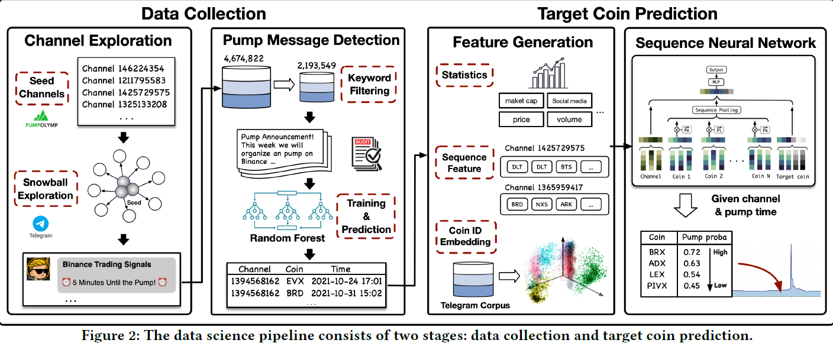
DATA PREPARATION

Slide 5
DATA PREPARATION
Total Channels : 1142
Inactive Channels : 564/1142
Added 137 channels using snowball strategy
Final number of channels : 715
Total messages : 4,674,822
Time period : Jan. 1, 2019, and Jan. 13, 2022

Slide 6
DATA PREPARATION
Keyword matching : "pump," "target," "hold," "sell," etc.
2,193,549 messages out of 4,674,822 messages filtered.
5,050 messages labelled as either pump or non-pump messages.
Pump announcements, pump countdowns, target coin releases, and post-pump reviews, while all other messages are labelled as non-pump messages.
RF AUC : 0.994
Identified 1,335 P&D samples from total 2,006 sessions based on the 37,525 pump messages identified by the RF model.
External data: https://finance.yahoo.com/

Slide 7
DATA PREPARATION
Below data was prepared by previous authors.
External data prepared using yahoo finance.
Features | Data Types
Date | object
Open | float64
High | float64
Low | float64
Close | float64
Adj Close | float64
Volume | float64
coin | object
Market_Cap | float64
Pct_Change | float64
Month_Year | object
PD | float64
isPenny | int64
drawdown | float64
drawdown_percentage | float64
Open_1m_avg | float64
Open_3m_avg | float64
Open_6m_avg | float64
Open_12m_avg | float64
Open_24m_avg | float64
Open_1m_std | float64
Open_3m_std | float64
Open_6m_std | float64
Open_12m_std | float64
Open_24m_std | float64
Open_1m_volatility | float64
Open_3m_volatility | float64
Open_6m_volatility | float64
Open_12m_volatility | float64
Open_24m_volatility | float64
channel_id | session_id | coin | exchange | pair | timestamp
1095533634 | 256 | APPC | binance | BTC | 2019-06-04 12:01:33+00:00
1095533634 | 258 | REQ | binance | BTC | 2019-06-08 13:00:02+00:00
1095533634 | 278 | ADX | binance | BTC | 2019-07-05 17:01:12+00:00
1095533634 | 285 | SNM | binance | BTC | 2019-08-07 16:59:48+00:00
1095533634 | 287 | DATA | binance | BTC | 2019-08-15 20:00:07+00:00
1095533634 | 293 | QSP | binance | BTC | 2019-08-29 18:00:05+00:00
1095533634 | 296 | DATA | binance | BTC | 2019-09-08 18:00:04+00:00
1095533634 | 299 | EDO | binance | BTC | 2019-09-23 12:59:59+00:00
Already Prepared Data
Yahoo Finance

Slide 8
DESCRIPTIVE ANALYSIS - I
Average OHLC range between $6 - $7.
Column1 | count | mean | std | min | 25% | 50% | 75% | max
Open | 182855.00 | 6.83 | 112.02 | 0.00 | 0.01 | 0.07 | 0.43 | 13484.76
High | 182855.00 | 7.40 | 125.44 | 0.00 | 0.01 | 0.07 | 0.46 | 13532.25
Low | 182855.00 | 6.30 | 98.64 | 0.00 | 0.01 | 0.06 | 0.40 | 8378.26
Close | 182855.00 | 6.82 | 112.01 | 0.00 | 0.01 | 0.07 | 0.43 | 13479.73
Volume | 182855.00 | 34460224.19 | 568590910.34 | 0.00 | 80450.50 | 776159.00 | 5421901.50 | 170549323809.00
Market_Cap | 182855.00 | 261226618.09 | 10789094183.38 | 0.00 | 1447.81 | 54294.00 | 1296911.64 | 4295679214331.27
Pct_Change | 182855.00 | inf |  | -100.00 | -3.74 | -0.03 | 3.55 | inf
PD | 182855.00 | 0.00 | 0.06 | 0.00 | 0.00 | 0.00 | 0.00 | 1.00
isPenny | 182855.00 | 0.85 | 0.36 | 0.00 | 1.00 | 1.00 | 1.00 | 1.00
drawdown | 182855.00 | 28.01 | 508.08 | 0.00 | 0.02 | 0.09 | 0.61 | 12977.71
drawdown_percentage | 182855.00 | 57.96 | 28.47 | 0.00 | 36.66 | 64.16 | 80.05 | 100.00
Open_1m_avg | 182855.00 | 6.97 | 106.29 | 0.00 | 0.01 | 0.07 | 0.43 | 5285.53
Open_3m_avg | 182855.00 | 7.51 | 116.14 | 0.00 | 0.01 | 0.07 | 0.44 | 4935.07
Open_6m_avg | 182855.00 | 8.11 | 126.47 | 0.00 | 0.02 | 0.07 | 0.44 | 4935.07
Open_12m_avg | 182855.00 | 8.51 | 134.02 | 0.00 | 0.02 | 0.07 | 0.45 | 4935.07
Open_24m_avg | 182855.00 | 8.18 | 133.50 | 0.00 | 0.02 | 0.06 | 0.43 | 4935.07
Open_1m_std | 182636.00 | 1.66 | 45.82 | 0.00 | 0.00 | 0.01 | 0.05 | 3785.30
Open_3m_std | 182636.00 | 2.96 | 62.89 | 0.00 | 0.00 | 0.02 | 0.10 | 3785.30
Open_6m_std | 182636.00 | 4.21 | 76.91 | 0.00 | 0.00 | 0.02 | 0.14 | 3785.30
Open_12m_std | 182636.00 | 5.57 | 90.19 | 0.00 | 0.01 | 0.03 | 0.18 | 3785.30
Open_24m_std | 182636.00 | 5.63 | 90.26 | 0.00 | 0.01 | 0.03 | 0.21 | 3785.30
Open_1m_volatility | 182392.00 | 0.13 | 0.45 | 0.00 | 0.05 | 0.07 | 0.11 | 18.90
Open_3m_volatility | 182417.00 | 0.14 | 0.43 | 0.00 | 0.06 | 0.08 | 0.11 | 11.07
Open_6m_volatility | 182417.00 | 0.15 | 0.42 | 0.00 | 0.06 | 0.08 | 0.12 | 7.96
Open_12m_volatility | 182417.00 | 0.16 | 0.41 | 0.00 | 0.07 | 0.08 | 0.12 | 7.06
Open_24m_volatility | 182417.00 | 0.17 | 0.40 | 0.00 | 0.06 | 0.08 | 0.12 | 7.06

Slide 9
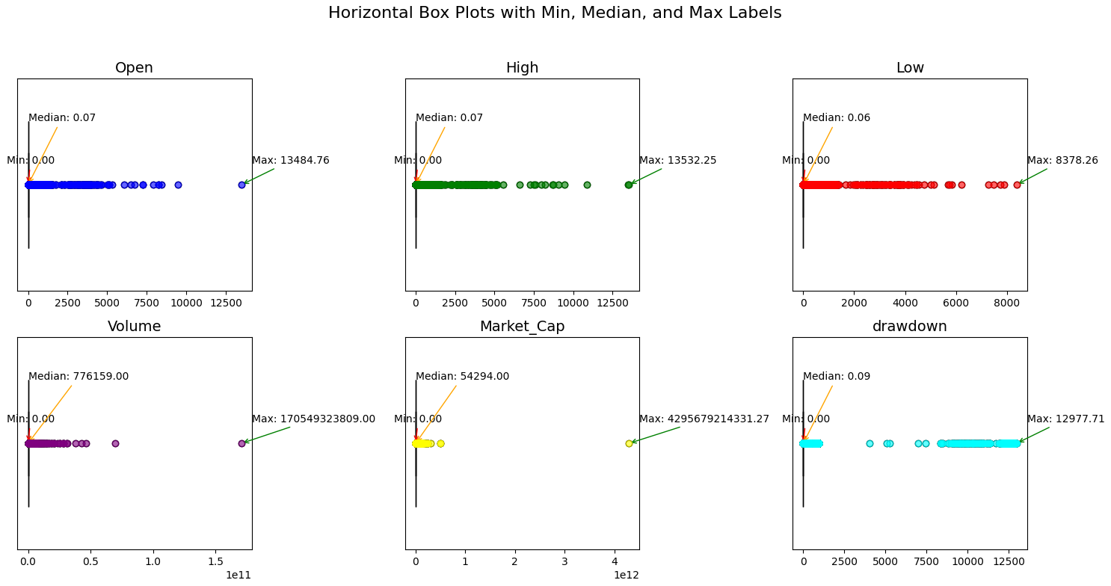
DESCRIPTIVE ANALYSIS-II
Distribution of Open, High and Low are similar.
Volume, Market Cap and Drawdown with different distributions.

Slide 10
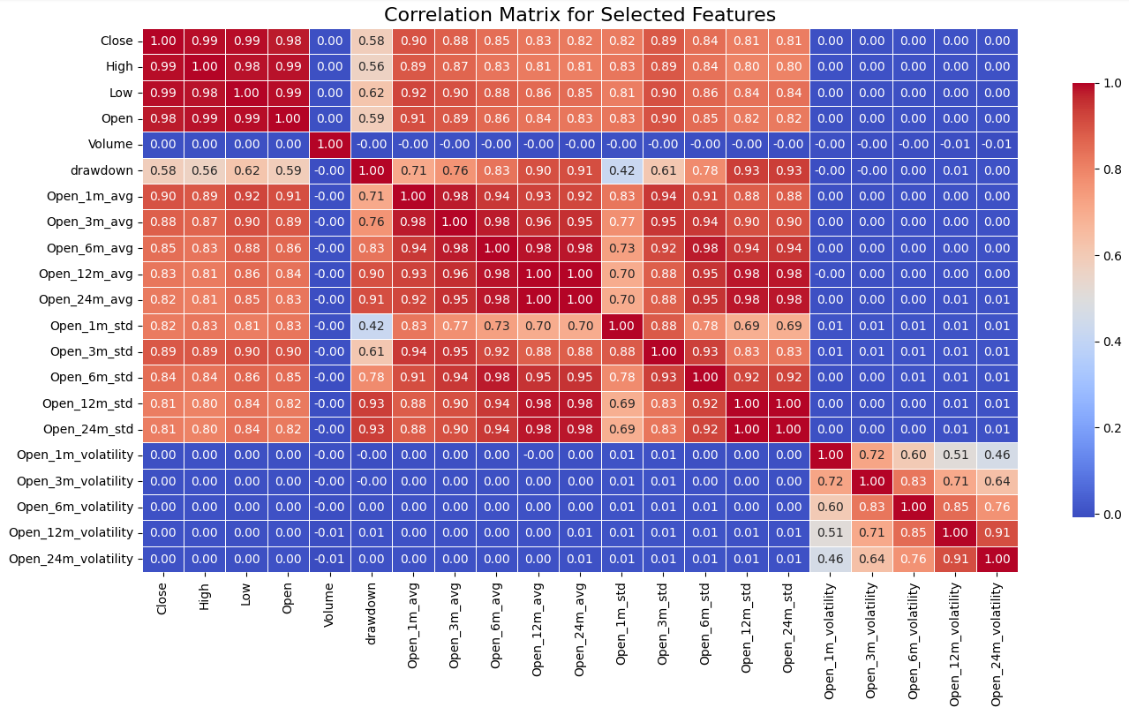
CORRELATION
Rolling features average, std dev and volatility correlated.

Slide 11
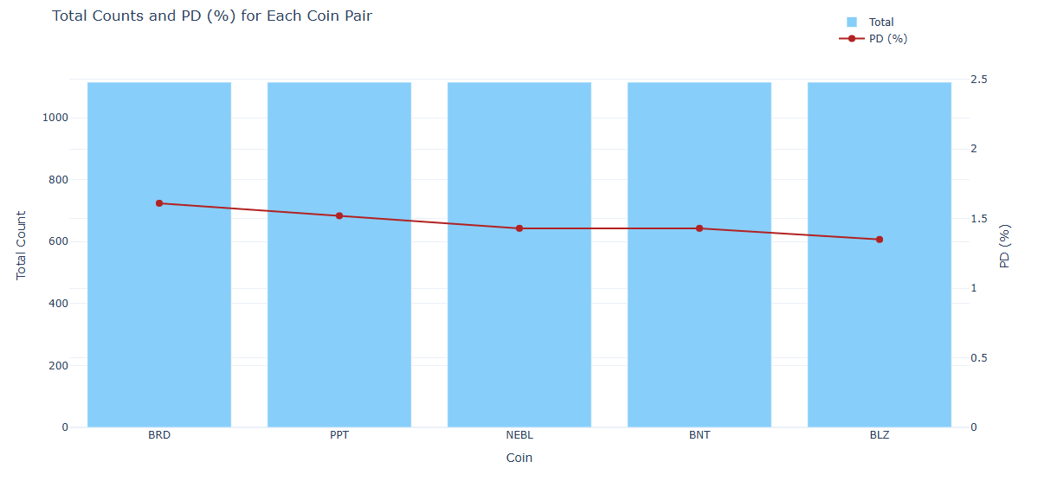
COINS WITH MOST PD EVENTS
Coins BRD, PPT, NEBL, BNT and BLZ has most number of PD events (approx. 30).

Slide 12
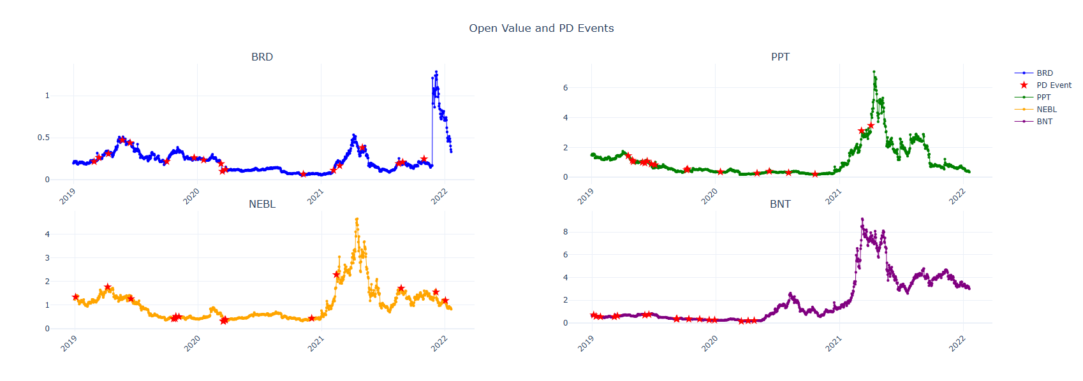
OPEN PRICE & PD EVENTS
PD events found with lower open price.

Slide 13
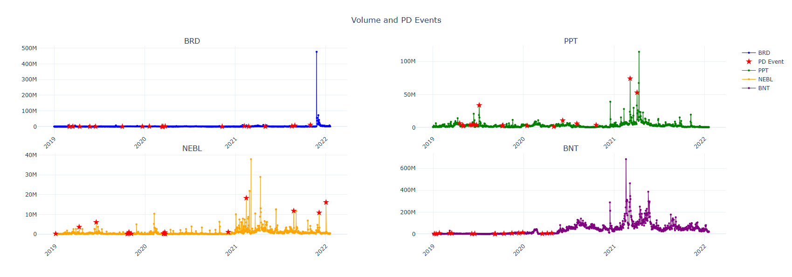
VOLUME & PD EVENTS
Volume are low when PD occurred.

Slide 14
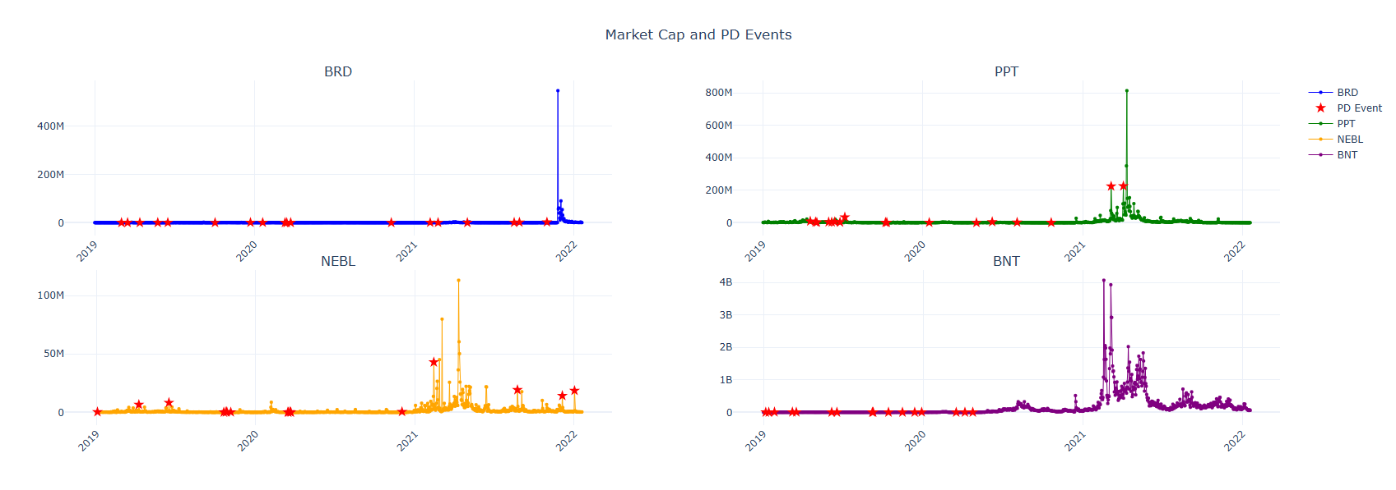
MARKET CAP & PD EVENTS
Market Cap = Volume * Closed Price
Similar behaviour like volume.

Slide 15
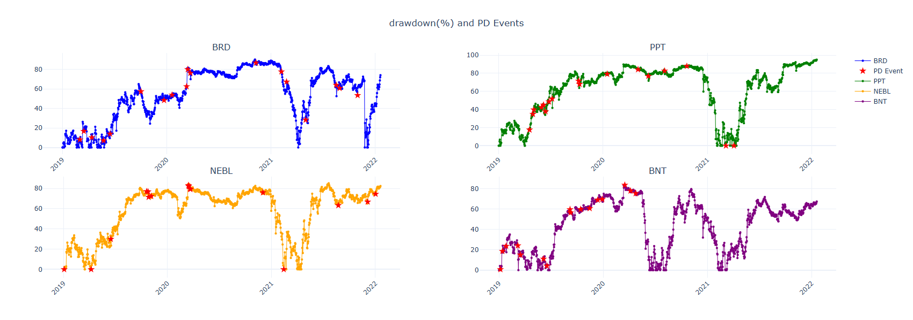
DRAWDOWN & PD EVENTS
Drawdown = Previous Peak- Current
Higher drawdown when PD occurred.

Slide 16
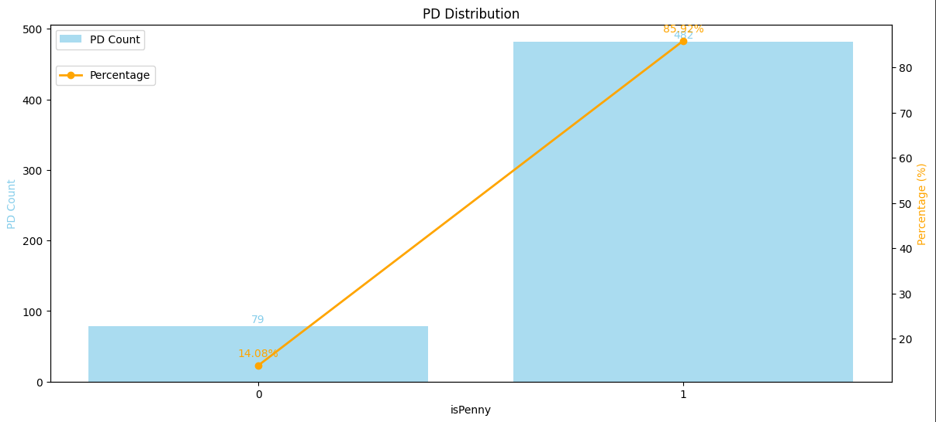
PD DISTRIBUTION & PENNY
85% of PD event has open price <$1.

Slide 17
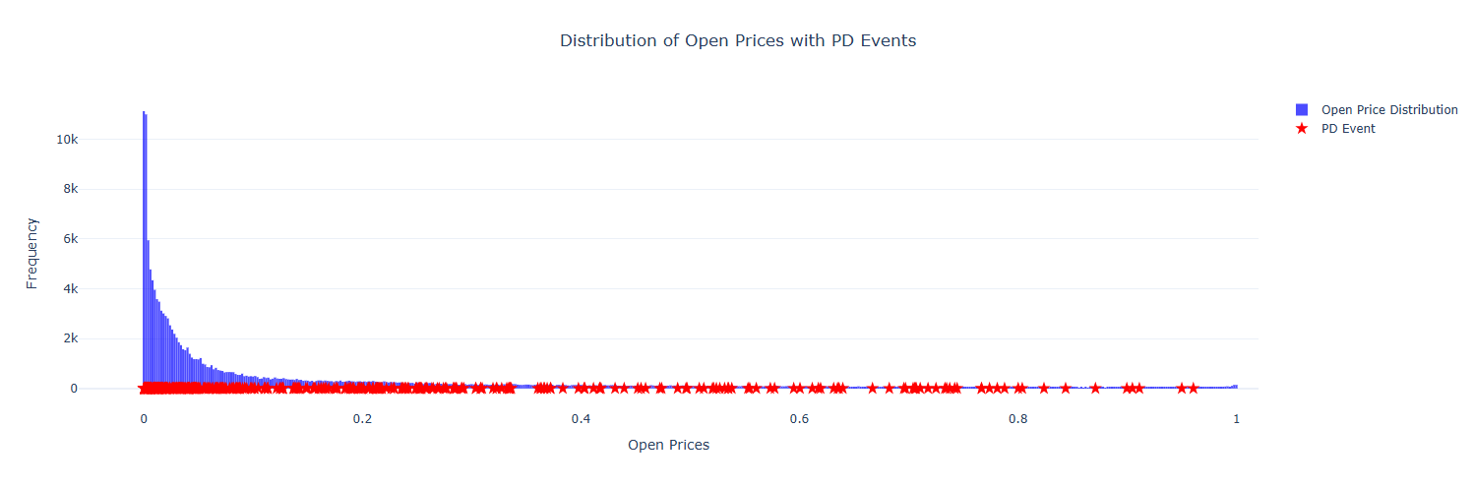
PD DISTRIBUTION & OPEN PRICES
Lower the open price more vulnerable to PD.

Slide 18
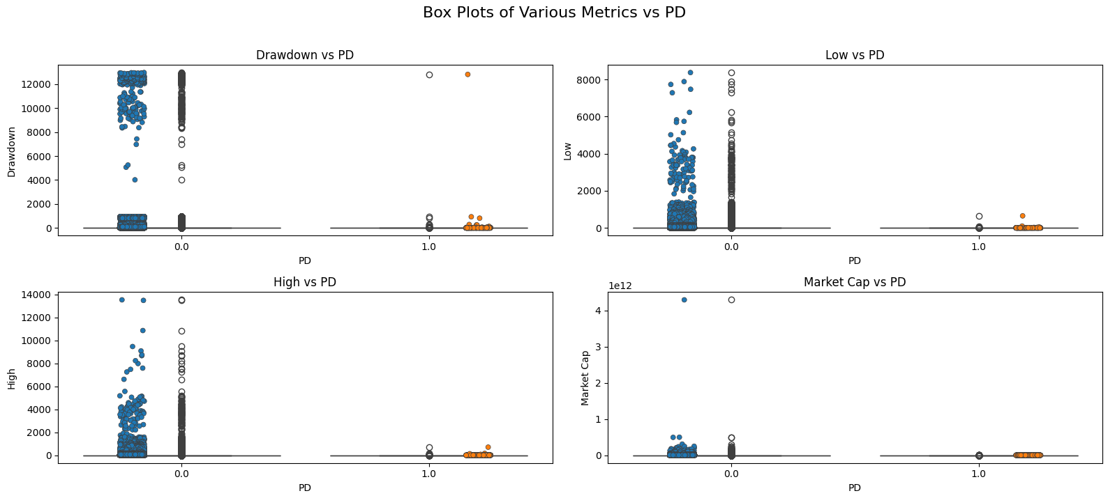
PD DISTRIBUTION FOR DIFFERENT FEATURES

Slide 19
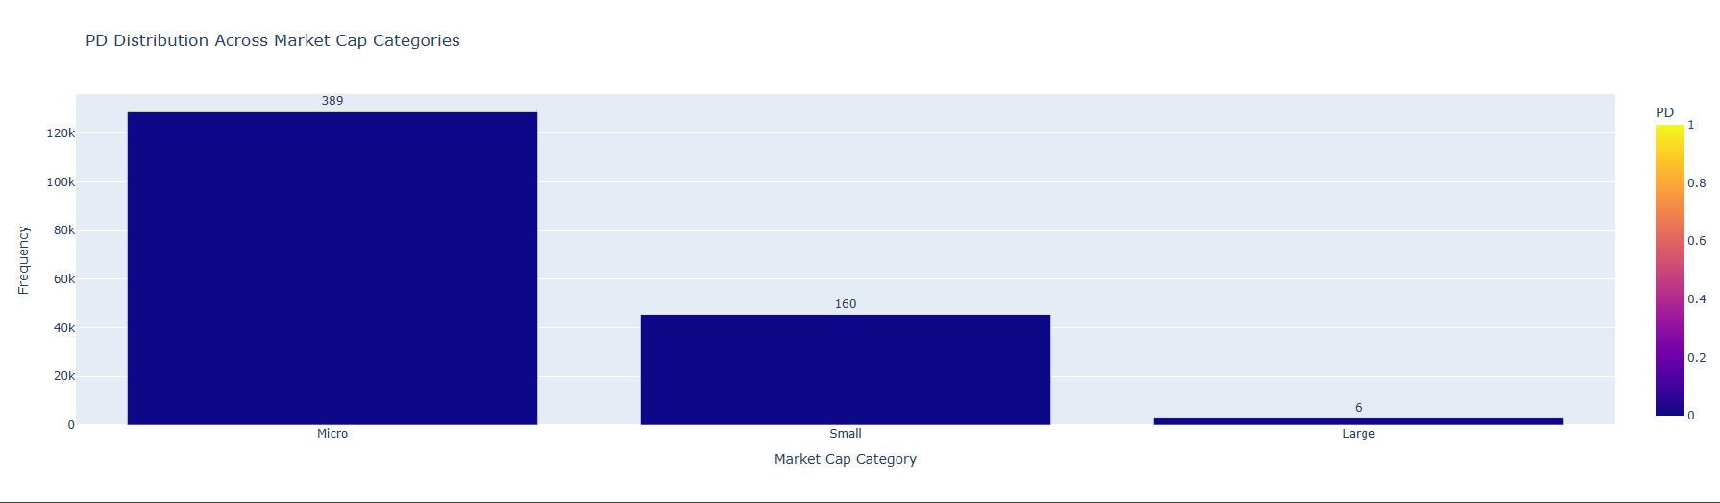
MARKET CAP DISTRIBUTION
Micro market category with most number of PD.

Slide 20
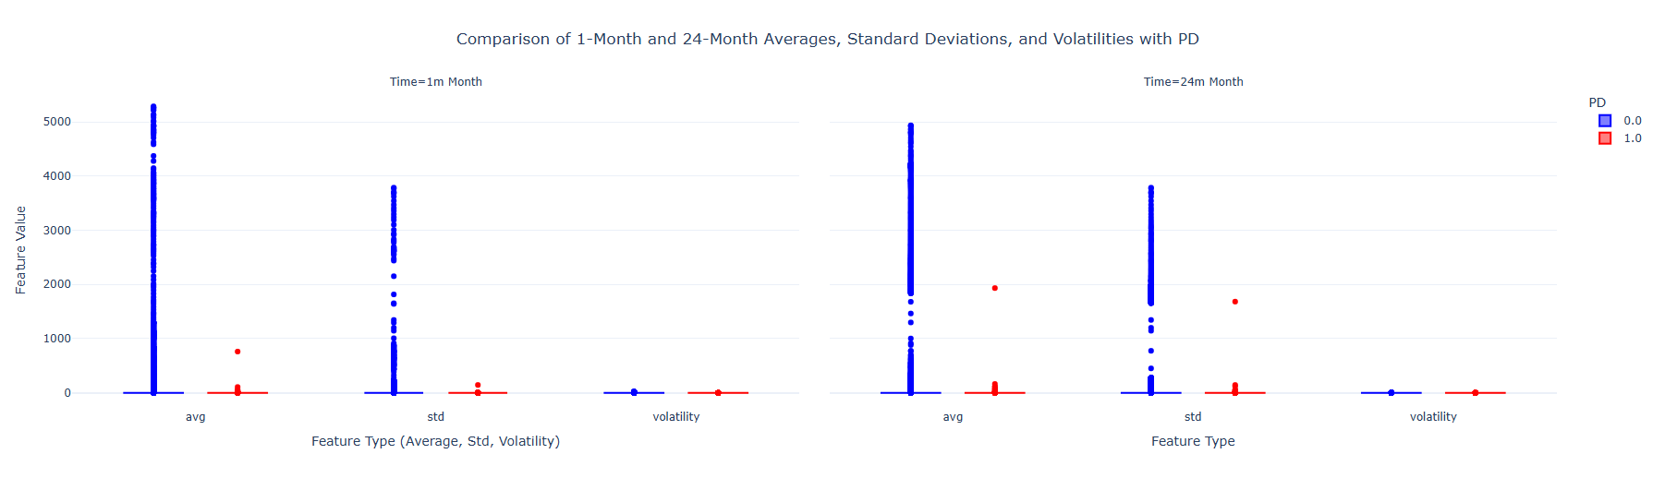
ROLLING FETAURES
Distribution of rolling feature changes with different window size.

Slide 21
ONE CLASS - SVM
Density based ML model for Anomaly Detection.
Trained on normal data points.
Predict outliers if it deviate from normal data points.
Kernel : Poly
Gama : Auto
Nu : 0.1 (10%)

Slide 22
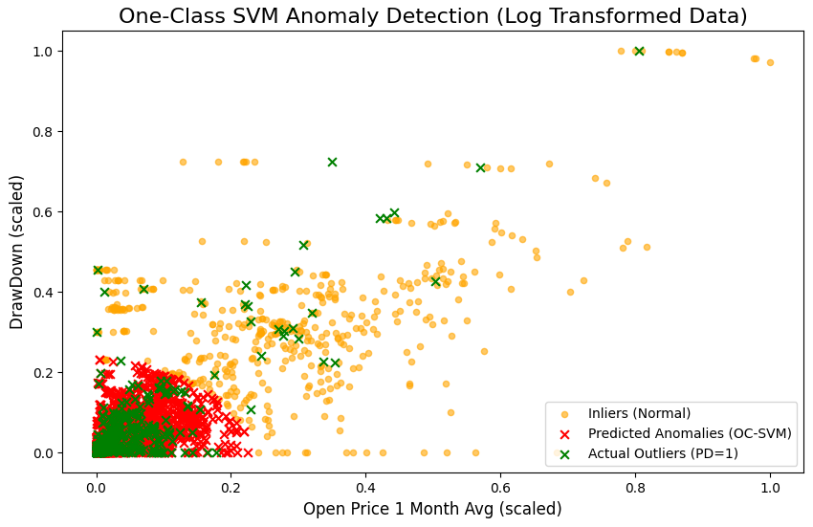
ONE CLASS - SVM
With features drawdown and average of one month open price, OC - SVM classified most of the PD data points correctly.
Model can be improved with complete set of data points and features.
Conformal Prediction can help to reduce false positive cases.

Slide 23
REFERENCES
Telethon api. https://docs.telethon.dev
J. Hamrick, F. Rouhi, A. Mukherjee, A. Feder, N. Gandal, T. Moore, and M. Vasek. The economics of cryptocurrency pump and dump schemes. Available at SSRN3310307, 2018.
M. La Morgia, A. Mei, F. Sassi, and J. Stefa. Pump and dumps in the bitcoin era: Real time detection of cryptocurrency market manipulations. In 2020 29th International Conference on Computer Communications and Networks (ICCCN), pages 1–9. IEEE, 2020.
Ccxt. (2018). ccxt/ccxt. Retrieved from https ://githu b.com/ccxt/ccxt.
https://github.com/Bayi-Hu/Pump-and-Dump-Detection-on-Cryptocurrency/tree/master
A. Dhawan and T. J. Putnin,š. A new wolf in town? pump-and-dump manipulation in cryptocurrency markets. Pump-and-Dump Manipulation in Cryptocurrency Markets (November 17, 2020), 2020.

Slide 24
THANK YOU !

